Slide 1
Meming/Counter-Meming Remixing Negative Memes to Deconstruct Stereotypes
Erika M. Sparby @Sparbtastic
CCCC 2017 esparby1@niu.edu
March 17, 2017 emsparb@ilstu.edu

Slide 3
Outline of this presentation
Some memes exploit stereotypes to gain a cheap laugh
Counter-meming may be a viable method of resistance
Meming is becoming a key skill for digital and professional writers

Slide 4
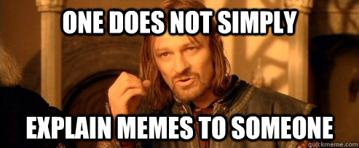
Memes
Images, videos, and other kinds of digital media that spread online
Image macro memes
specific kinds of memes that include an image with text superimposed on the top and bottom
Top text
Central figure
Bottom text, often a punchline

Slide 5
Memes are a powerful form of public writing
Ryan Milner’s (2013) study on Occupy Wall Street memes
memes act as a “common language” with which people can have discussions on a global scale.
Stephanie Vie’s (2014) study of the Human Rights Campaign logo
memes provide a voice to the public

Slide 6
Memes are a powerful form of public writing
Limor Shifman (2014)
Memes can also continue traditions of silencing marginalized voices

Slide 7
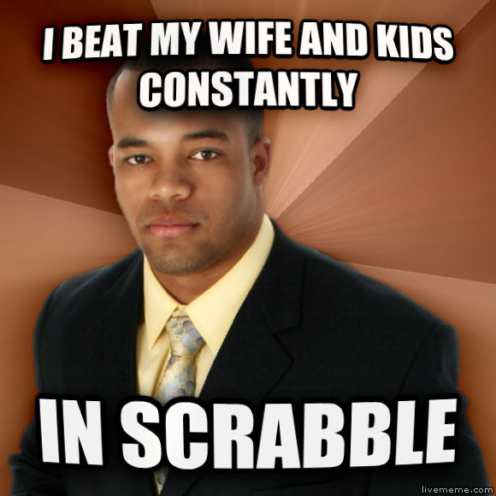
Successful Black Man

Slide 8
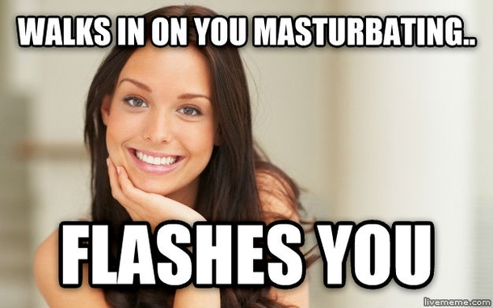
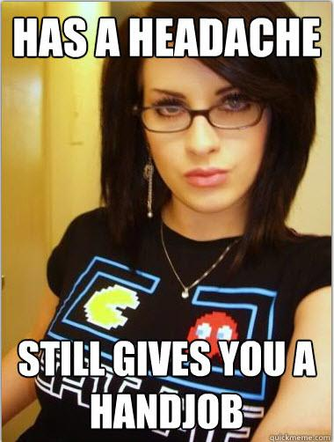
Good Girl Gina and Cool Chick Carol

Slide 9
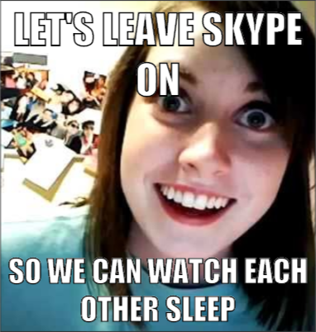
Overly Attached Girlfriend

Slide 10
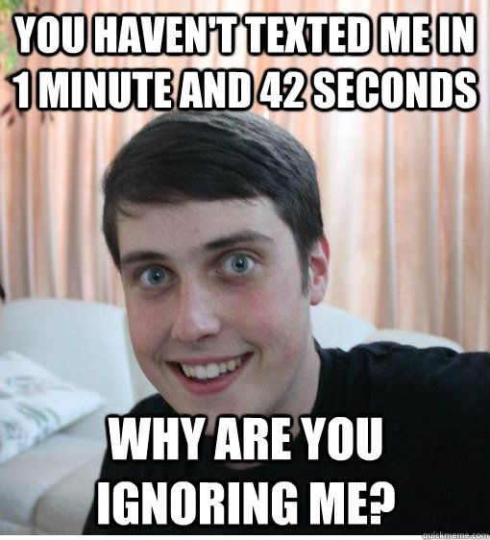
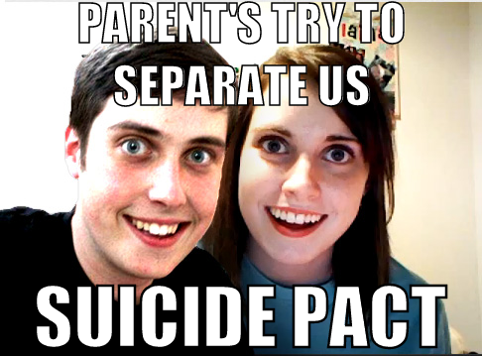
Overly Attached Boyfriend

Slide 11
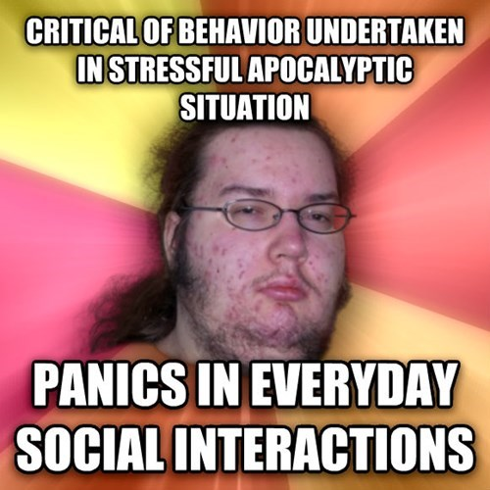
Butthurt Dweller

Slide 12
Counter-Meming
Mike Godwin (1994)
“crafting good memes to drive out the bad ones”
Michele Knobel & Colin Lankshear (2007)
“the deliberate generation of a meme that aims at neutralizing or eradicating potentially harmful ideas”

Slide 13
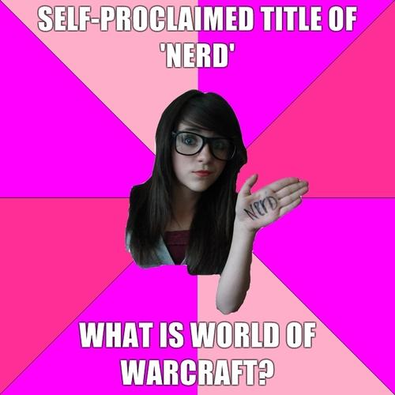
Fake Geek Girl (aka Idiot Nerd Girl)

Slide 14
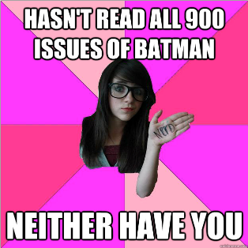
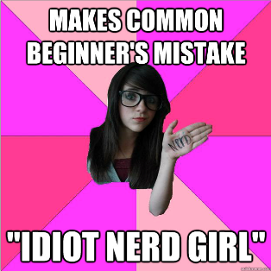
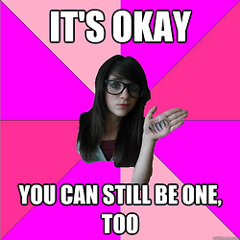
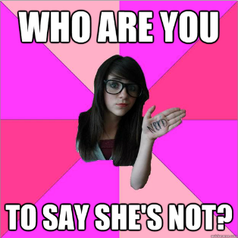
Fake Geek Girl Counter-Memes

Slide 15
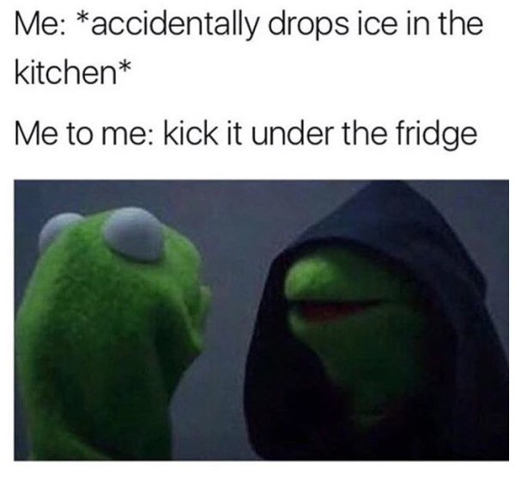
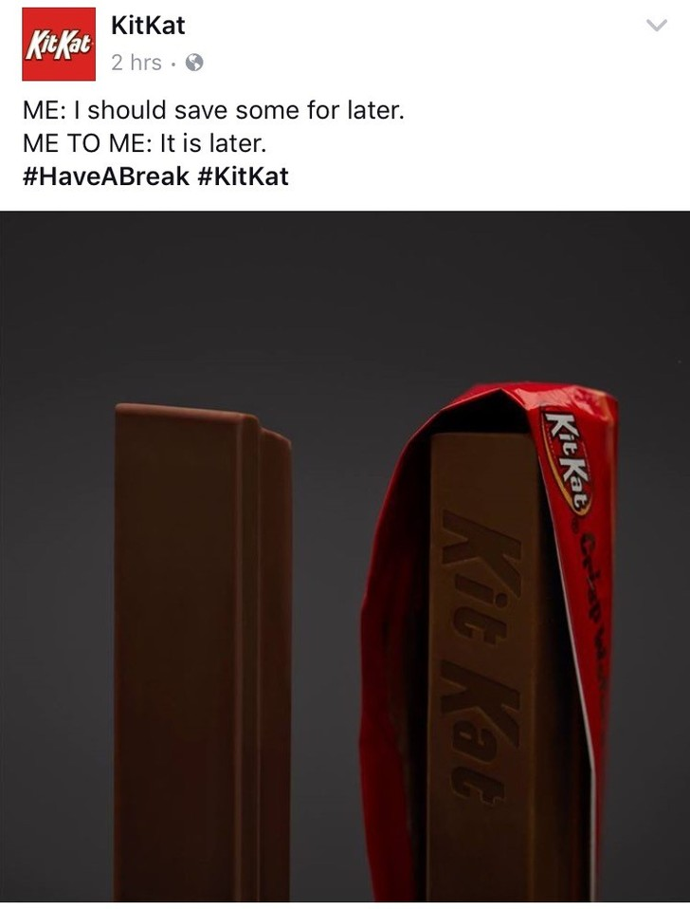
Evil Kermit and KitKat

