Slide 1
Anonymity, Design, and Identification: The Rhetorical Construction of Identity on Digital Social Media
Erika Sparby Twitter: @Sparbtastic
Northern Illinois University Email: esparby1@niu.edu
CCCC 2016

Slide 2
Anonymity, Design, Ethos, and Identification: The Rhetorical Construction of Memetic Identity on Digital Social Media
Erika Sparby Twitter: @Sparbtastic
Northern Illinois University Email: esparby1@niu.edu
CCCC 2016

Slide 3
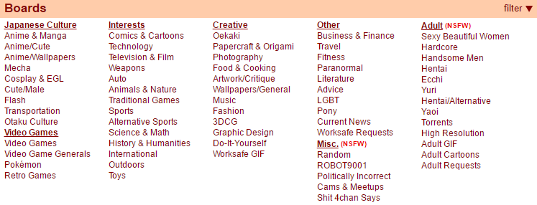
4chan.org/b/

Slide 4
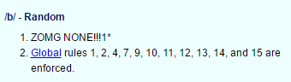
4chan’s Design
Anonymity
Ephemerality
Simple/few rules
Low moderation

Slide 5
/b/’s Ethos
Lawlessness
Unaccountability
Julian Dibbell: “A Rape in Cyberspace”
“[T]here were few MOOers who had not, upon their first visits as anonymous ‘guest’ characters, mistaken the place for a vast playpen in which they might act out their wildest fantasies without fear of censure. Only with time and the acquisition of a fixed character do players tend to make the critical passage from anonymity to pseudonymity, developing the concern for their character’s reputation that marks the attainment of virtual adulthood.”

Slide 6
/b/’s Collective Identity
Mary Chakyo, Portable Communities
A collective identity is a group of users with a “specific, often strong, sense of themselves as a social unit” (7).

Slide 7
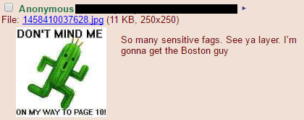
/b/’s collective identity
Misogynistic
Racist
Homophobic
Transphobic
Ableist
Pejorative terms

Slide 8
/b/’s Collective Identity - Demographics
Whitney Phillips, This is Why We Can’t Have Nice Things
English-speaking American
Economic privilege
Generation Y
4chan, “Advertise”
70% male
47% from United States
Ages 18-34

Slide 9
/b/ and Transanons

Slide 10
/b/ and Memeticism
Richard Dawkins, The Selfish Gene
Cultural artifacts that “propagate themselves… by leaping from brain to brain via a process which, in the broad sense, can be called imitation” (192).
Examples are “tunes, ideas, catch-phrases, clothes fashions, ways of making pots or of building arches” (192).

Slide 11
/b/’s Memetic Response to Transpeople

Slide 12
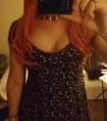
A Rupture in /b/’s Memetic Collective Identity

Slide 13
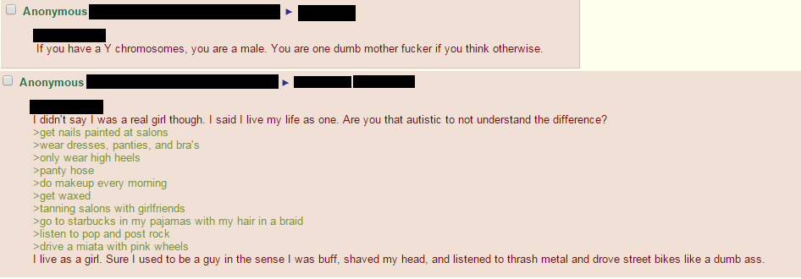
A Rupture in /b/’s Memetic Collective Identity

Slide 14
A Rupture in /b/’s Memetic Collective Identity

Slide 15
The Reality of /b/’s Collective Identity
Diverse, not monolithic
Performance
Behavior = memetic, ≠ reflection of reality
Constitutive rhetoric + dissention = collective identity rupture
Negative behaviors can be counter-memed

Slide 16
Works Cited
“Advertise.” 4chan. 2015. Web. 6 Dec 2015.
Bernstein, Michael S. Andrés Monroy-Hernández, Drew Harry, Paul André, Katrina Panovich, and Greg Vargas. “4chan and /b/: An Analysis of Anonymity and Ephemerality in a Large Online Community.” MIT Computer Science and Artificial Intelligence Laboratory (2011). Web. 6 Dec 2015.
Chakyo, Mary. Portable Communities: The Social Dynamics of Online and Mobile Connectedness. Albany: SUNY Press, 2008. Print.
Dawkins, Richard. The Selfish Gene [1976]. Oxford: Oxford UP, 1989.
Phillips, Whitney. This is Why We Can’t Have Nice Things: Mapping the Relationship between Online Trolling and Mainstream Culture. Cambridge, MA: MIT P, 2015. Print.
“Rules.” 4chan. 2015. Web. 7 Dec 2015.

